Slide 1


Conversations on COVID-19: A VIRtual Exchange of Stimulating Studies (VIRESS)
June 23, 2020

Slide 2

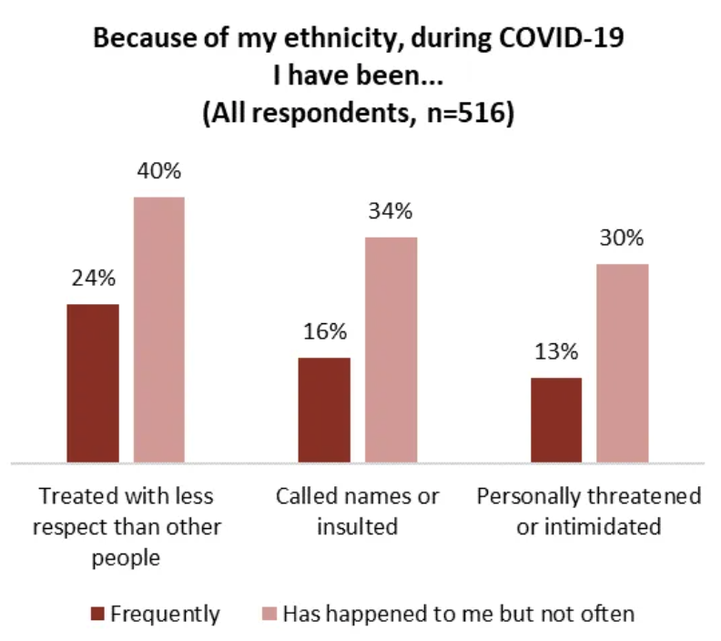
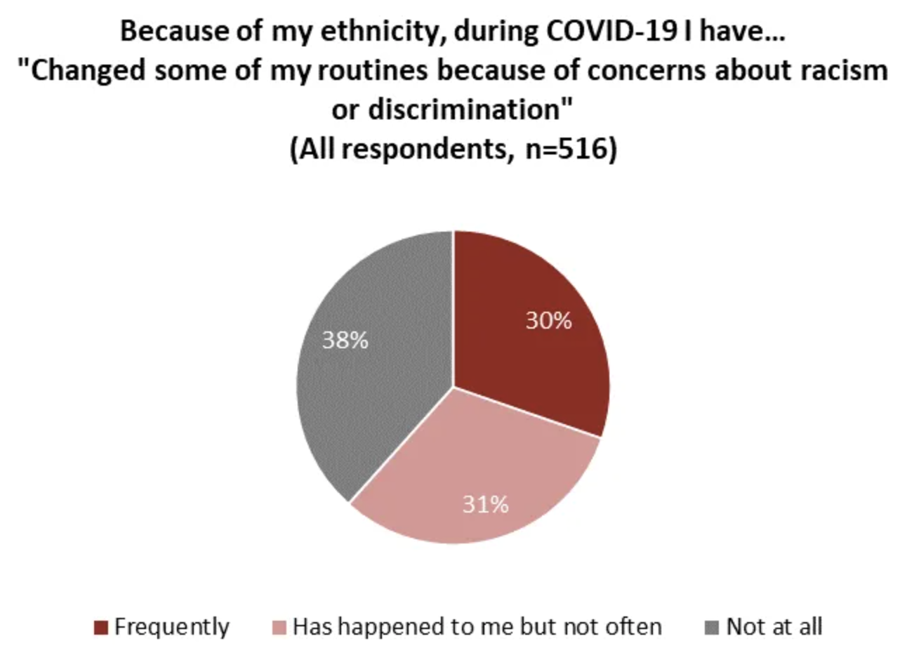
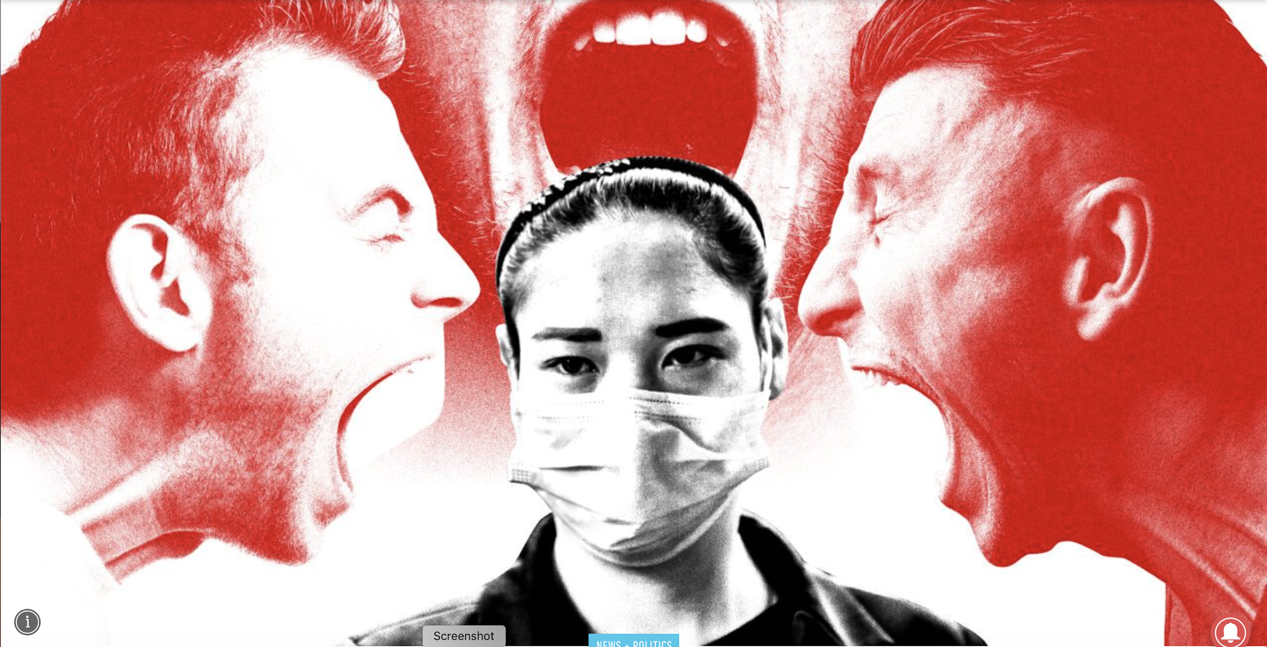
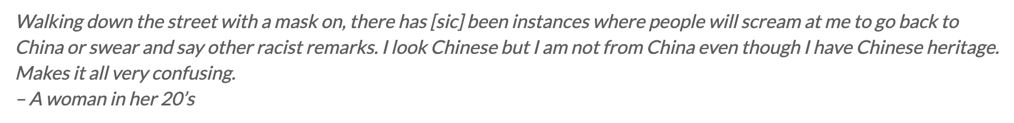
Chinese Canadians’ Experience of Discrimination During COVID-19
Kim Noels et al., Psychology, in collaboration with the Angus Reid Institute
http://angusreid.org/racism-chinese-canadians-covid19/

